Slide 1
Wildlife Object Detection Using YOLOv11
Presented by: Jaleah Beason
Course: cs440
Date: 12-9-25

Slide 2
Objective
  Build and train a wildlife detection model using YOLOv11
  Evaluate detection accuracy across multiple species
  Identify model limitations and explore drone/mapping applications for wildlife monitoring

Slide 3
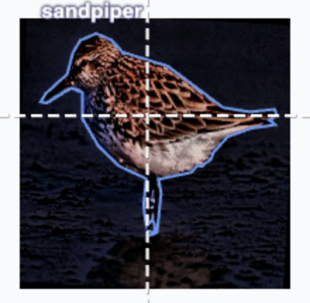
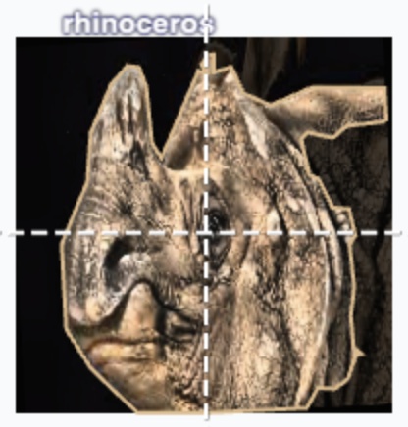
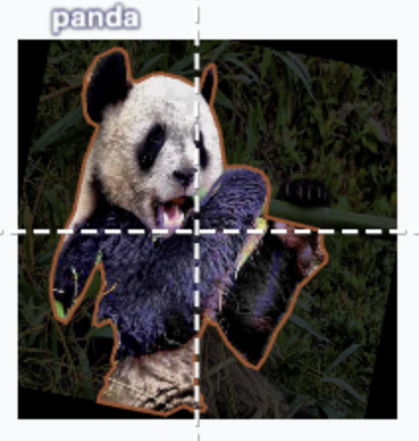
Dataset Overview
Source: Roboflow Wildlife dataset
Contains: 316 total images Dogs, horses, birds, pandas, zebras, rhinoceros, etc.
Labels: YOLO-formatted bounding boxes
Characteristics:
Mixed environments and lighting
Variation in species size and frequency

Slide 4
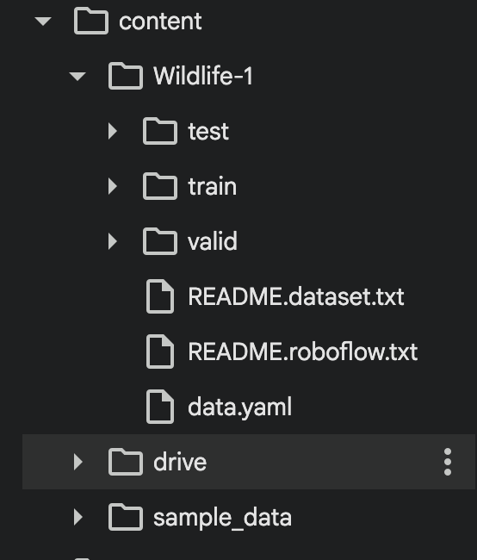
Model Architecture & Training Setup
Model: YOLOv11n (lightweight, fast)
Training Settings:
15 epochs
Image size: 640×640
Batch size: 16
Default optimizer
Run in Google Colab
Issue Encountered:
No runs/ directory created
Training outputs (predictions, curves, weights) not saved
Led to blank sample inference images

Slide 5
Results Summary
Overall Metrics:
Precision: 0.391
Recall: 0.335
mAP@0.5: 0.412
mAP@0.5:0.95: 0.286
Strengths:
Better detection for clear, frequently seen species (zebras, dogs, horses)
Weaknesses:
Poor detection for smaller or underrepresented species
No saved prediction visuals due to missing runs directory

Slide 6
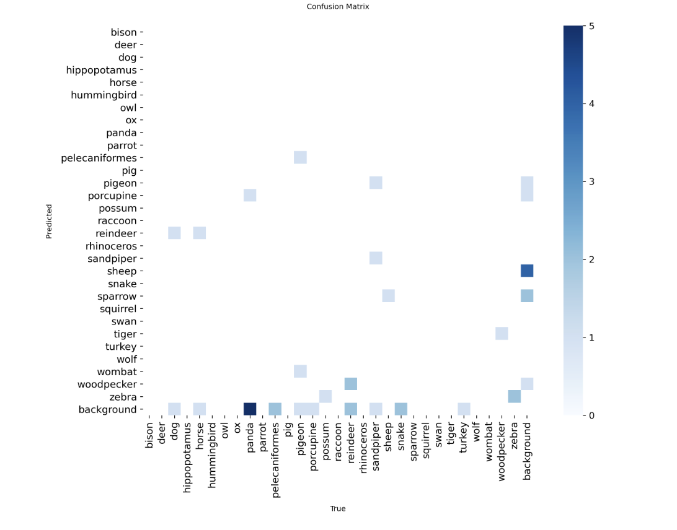
Ex.

Slide 7
Drone/Mapping Integration Reflection
How drones support detection:
Collect large amounts of wildlife imagery quickly
Provide consistent aerial viewpoints
Enable real-time wildlife monitoring
Potential limitations:
Animals appear smaller → harder to detect
Aerial images affected by shadows, blur, weather, canopy cover
Requires retraining model on drone-captured images
Mapping tools:
Useful for tracking animal locations
Depend on accurate model predictions

Slide 8
Next Steps
Lessons Learned:
YOLOv11n can detect large/clear animals reasonably well
Dataset balance greatly affects model performance
Missing runs directory limits full evaluation
Next Steps:
Fix output-saving issue in Colab
Train longer (more epochs) or try larger YOLOv11 versions
Improve dataset balance or increase sample size
Incorporate drone-based images for better real-world generalization

